Slide 1
STOCK SENTIMENT ANALYSIS
AMAR CHOUDHARY
MECHANICAL ENGINEERING
22117021

Slide 2
BRIEF SUMMARY:-
1)-In this project, our goal is to collect data, reports, and articles related to specific stocks such as Tesla, Apple, Microsoft, and others.
2)-We will label this information using sentiment analysis, categorizing it as positive, negative, or neutral, corresponding to the values 1, -1, and 0, respectively.
3)-Using these labeled values, we will employ machine learning algorithms to generate buy and sell signals based on the financial data of these stocks.
4)-After that we will do apply stop loss and take profit region for every signal and try to capture our target weather it is loss or profit

Slide 3


Data Extraction
With the help of NewYorkTimes Api I extracted all the data related to the stock by giving input as stock’s keyword and then fetch all the data from period 2010 – 2023.
I picked up two stocks specifically AAPL,TSLA.

Slide 4
Generating Labels
First I cleaned the texual data that I fetch from api by using NLP techniques regex and stop words removal.
Then I use Vader Sentiment Analyst library to give a news as positive, negative or neutral sentiment. Note I not used TextBlob for Sentiment Analysis.

Slide 5
Merging Textual and Financial Data
We merge both data (financial data and textual data with labels or signals) in such a way in which we no news came it means on that day the signal will be zero for financial dataset.
So in this way, Now our financial data also has three signals that are no signal, buy signal and sell signal

Slide 6
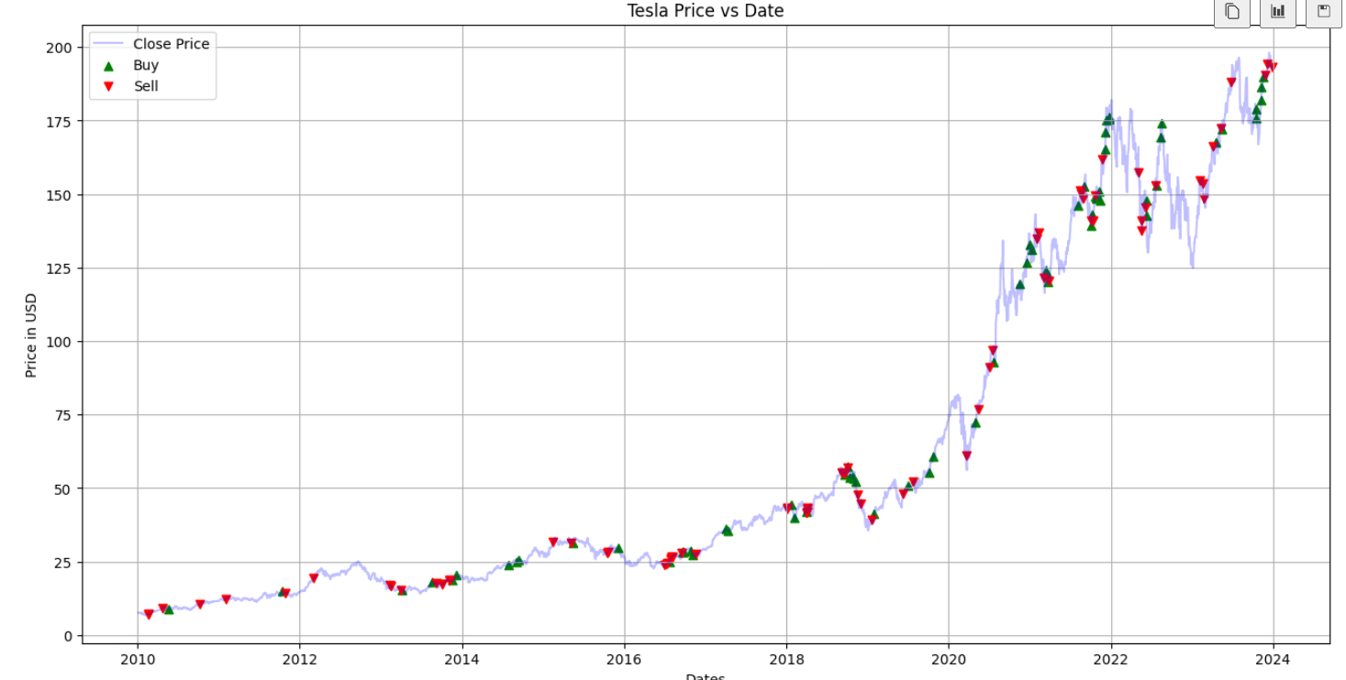
Plotting graph having buy and sell signal

Slide 7
Adding Stop loss and Take profit
Now we have signals for both call and put or buy and sell , Now our goal is to find stop loss and take profit region so that we can compute either the closing price will hit stop loss and book loss or hit take profit to book profit in the following days.
By using ATR , we were made stop loss and take profit for the signal.

Slide 8
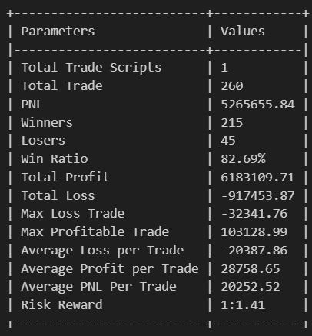
Final Step- Backtesting
Now its time to do backtesting , and check our signals accuracy weather they are capble of booking profit or not from news.
In Backtesting We compute following things like,
PNL, Sharpe Ratio, Max Drawdown, No. of winner Trades, no . Of losing Trades , etc

